Slide 1

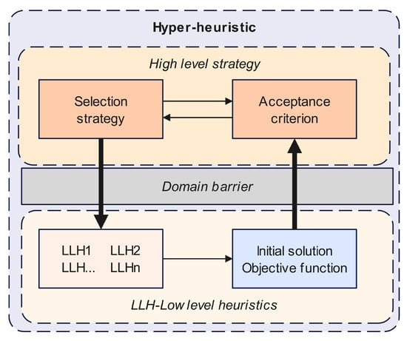
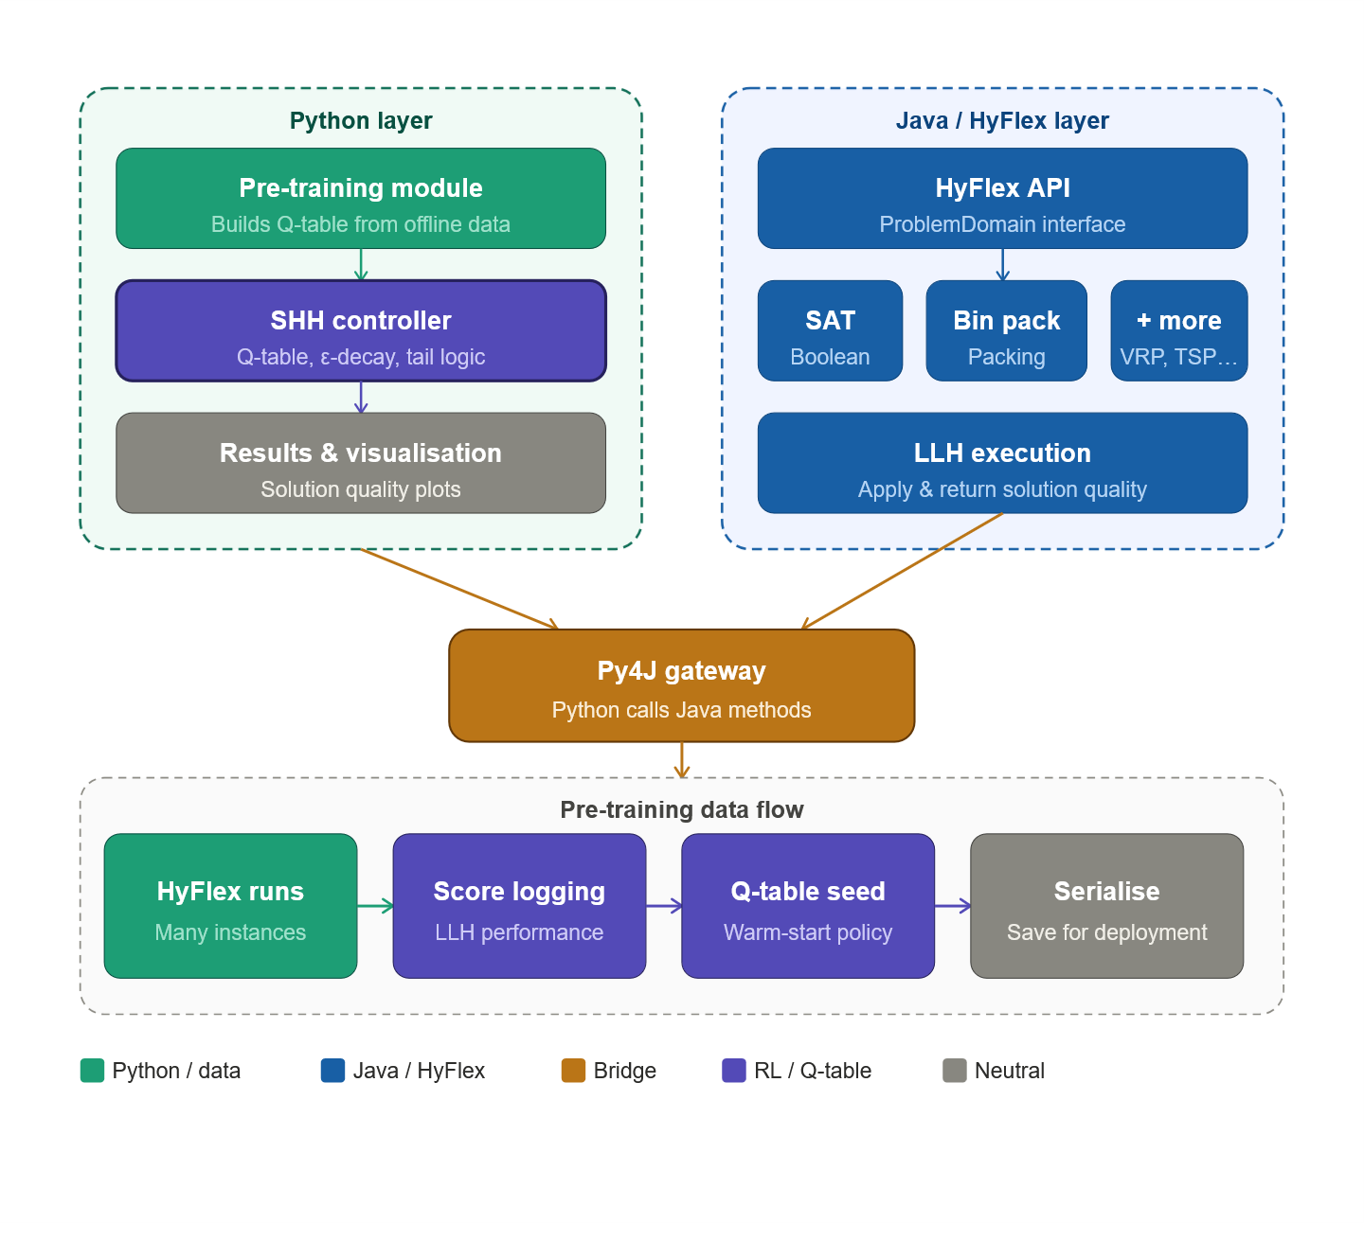
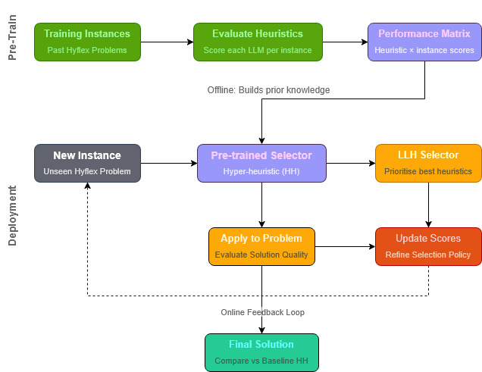
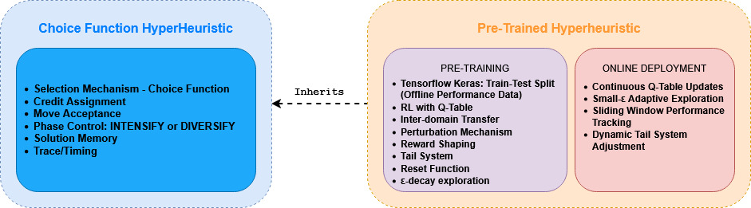
Pre-Trained Hyper-Heuristics for Optimisation Tasks
Motivation
Aims and Objectives
Transfer Learning Between Problem Instances: Allows hyper-heuristic exploit previously learning heuristic performance patterns
Improving Early-Stage Solution Quality: Helps hyper-heuristics prioritise heuristics that work well with similar
Stabilise Heuristic Selection Behaviour: Heuristic Selection is highly stochastic. Learns consistent patterns across multiple training runs
Create and implement a hyperheuristic that operates on the problem domains in Hyflex [1], using low-level heuristic selection and acceptance methods.
Attach a Python-Java Gateway that runs Hyflex hyperheuristics on the problem domains to visually compare results across multiple runs and instances.
Attempt to see if pre-training a hyperheuristic is achievable by leveraging prior experience from known problem domains to improve performance on unseen instances.
Methodology
[2] Generic Hyper-Heuristic Structure
Hyperheuristic build using
Implementation
Py4J Java Gateway
Pre-Training Hyperheuristic
Results and Conclusion
Results discussion in here
References
[1] - seage. 2025. “GitHub - Seage/Hyflex: Some Hyper-Heurisics from CHeSC 2011 Challenge and the Challenge Results Reproducing Attempts.” GitHub. 2025. https://github.com/seage/hyflex.
[2] -
[3] -

